Slide 1
LECTURE 1 HISTORY OF CIVILIZATION AND GROWTH OF COMMUNITIES
HISTORY OF URBAN PLANNING

Slide 2
Define History
History is the study of human past. It is a field of research which uses a narrative to examined and analyze the sequence of event and it often attempts to investigate objectively the pattern of cause and effect that determine events.
Continuous methodical record, in order of time of important public events, study of formation and growth of communities and nations, whole train of events connected with particular country, person or thing and past events in general course of human affairs.

Slide 3
WHY TO STUDY URBAN PLANNING HISTORY
Urban history is a field of history that examines the historical nature of cities and towns, and the process of urbanization. The approach is often multidisciplinary, crossing boundaries into fields like social history, architectural history, urban sociology, urban geography and business history.
A study of towns and town planning over the years can be a source of inspiration and guidance.
The greater the insight gained into ideas, inspiration, successes and failure of predecessors in town planning and building, the greater will be the understanding of qualities of environment that enable people as a community to enjoy healthy and agreeable life.

Slide 4
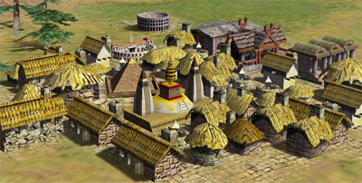
CIVILIZATION
An advanced state of human society in which a high-level of culture, science, industry and government has been reached.
A civilization is any complex society characterized by urban development, symbolic communication forms and a perceived separation from and domination over the natural environment by a cultural elite.

Slide 5
Prehistoric human life
Prehistoric human life is defines by Three age system which is created by Christian Thomsen. It is consist of three principal.
1. Stone Age
Paleolithic
Mesolithic
Neolithic
2. Bronze Age
3. Iron Age

Slide 6
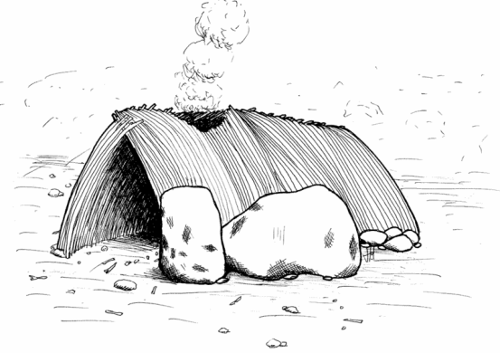
Paleolithic or “Old” Stone Age
In this period humans use materials from plants and trees for shelter. It was also believed to be a time when ancient man partook of an omnivorous diet—hunting game and gathering berries. They lived in small groups of about 20-30 people
It is widely believed that during the Paleolithic era, fire was first used for cooking meat after the discovery of the “two stones” technique of creating fiery sparks that could ignite a blaze.
Developed simple tools from stone, bone or wood.

Slide 7
Mesolithic or “Middle” Stone Age
In this age, man began streamlining tools with the discovery of flint. This hard stone was easily sharpened and it became an effective material for creating weapons and tools.
At this time, humans also began settling in one area, although they still relied on hunting and gathering to sustain themselves.

Slide 8
Neolithic or “New” Stone Age
About 11,000 years ago, most likely due to the increase in settlements, agriculture was developed. Ancient man, having accumulated a substantial knowledge of edible plants, must have experimented in replanting certain varieties within the vicinity of settlements, the beginnings of farming communities.
Additionally, the domestication of wild animals allowed settlers to have more convenient access to protein. And the use of stone, and wood as materials led to the development of highly productive tools, such as plows and the mortar and pestle. The quality of life greatly improved as a result.

Slide 9
To Be Continue…..
FIRST TOWNS DEVEOLP IN NEOLITHIC AGE
Catal Huyuk (Modern Turkey)
Jerico (Modern Israel)

Slide 10
To Be Continue…..
CHRACTERSTICS OF NEOLITHIC CIVILIZATION
Advanced Cities (Centers for Trade)
Specialized Workers
Complex Institutions (government, Religion and Economy)
Record Keeping
Advanced Technology
System of Government
Written Language

Slide 11
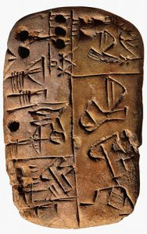
BRONZE AGE
The Bronze Age is a historical period characterized by the use of bronze, proto-writing, and other early features of urban civilization.
The Bronze Age is the second principal period of the three-age Stone-Bronze-Iron system.
Manufacturing its own copper and alloying with tin, arsenic, or other metals, or by trading for bronze from production areas elsewhere.
Bronze Age cultures differed in their development of the first writing. According to archaeological evidence, cultures in Mesopotamia and Egypt developed the earliest viable writing systems.

Slide 12
To Be Continue…..
Bronze tools and weapons are sharper than stone tools.
Gradually the use of bronze spread across Europe.

Slide 13
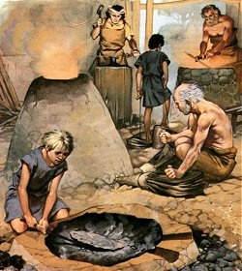
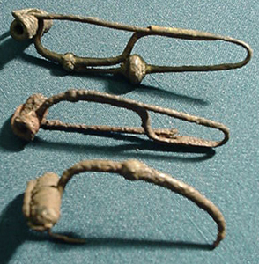
IRON AGE
Iron Age, marks the period of development of Technology, when the working of iron came into general use, replacing bronze as the basic material for implements and weapons.
Bronze could be melted and poured into moulds, whereas iron could not because the process made it too brittle to use as weapons or tools.
Technology also advanced weaponry with the development of catapults, better swords, and body armor.
Also ornamental items, such as jewelry, hair pins, etc.

Slide 14
LIFE IN THE IRON AGE
Different settlements
Hillforts
Single farming units
Within the hillfort proper, families would have lived in roundhouses.
A roundhouse is a teepee-like structure covered by a daub (a mixture of soil, straw, animal manure and soil).
Inside the roundhouse, a fire would burn constantly. The fire would be the source of light and heat for the structure, as well as the means to cook the food.
The majority of entrances to roundhouses face to the east.

Slide 15
ACTIVITY AREA IN THE ROUND HOUSE

Slide 16
IMPORTANT FEATURES OF IRON AGE
Early government system emerged to solve water and land issues.
Other professions like weaving, tanning leather and pottery making flourished.
As business grew, artisans needed to keep records and system of writing developed to protect the properties.
Trade, writing and art were all important to this kind of culture known as civilization.

